Slide 1
Quality of Life For Persons with Spinal Cord Injury in rural Tanzania
Dr Haleluya Moshi - Tanzania

Slide 2
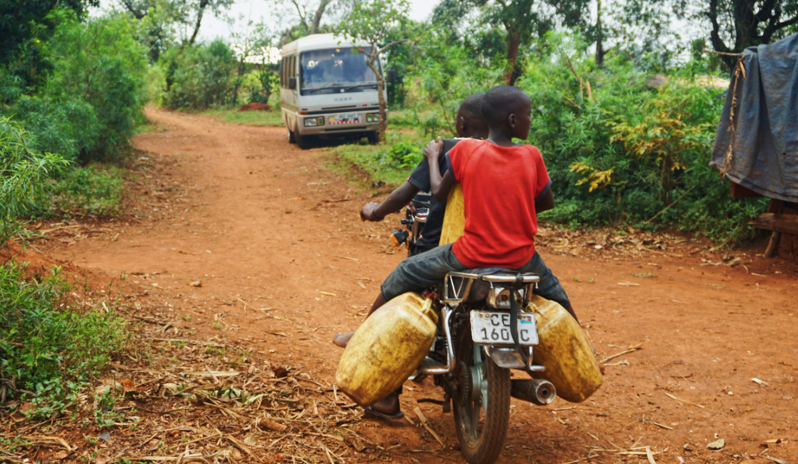
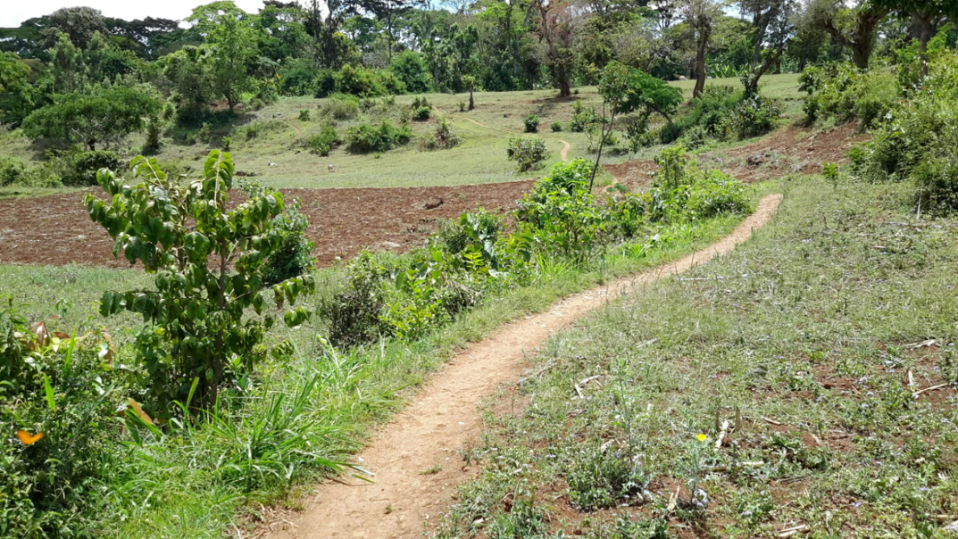
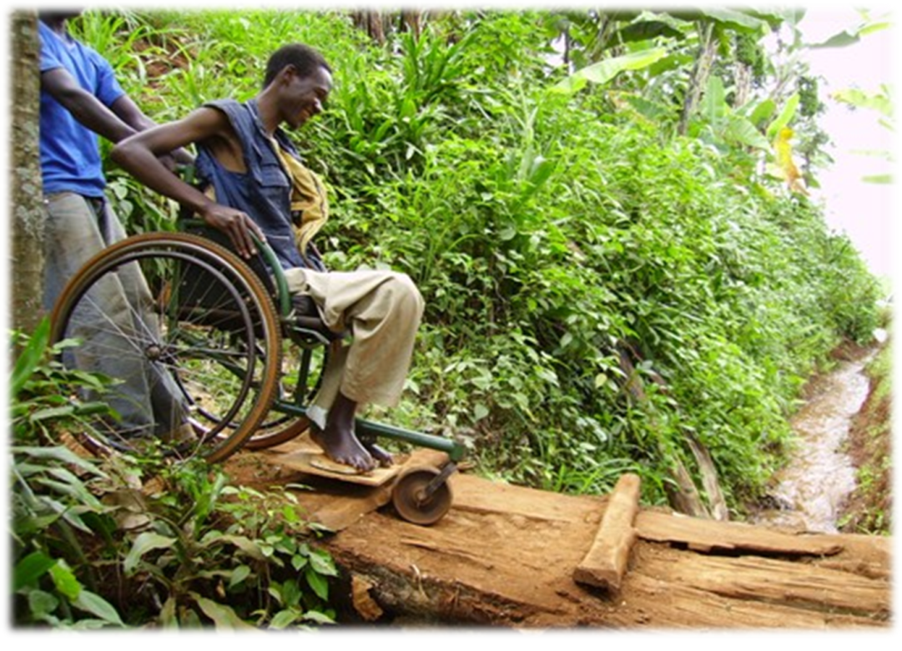
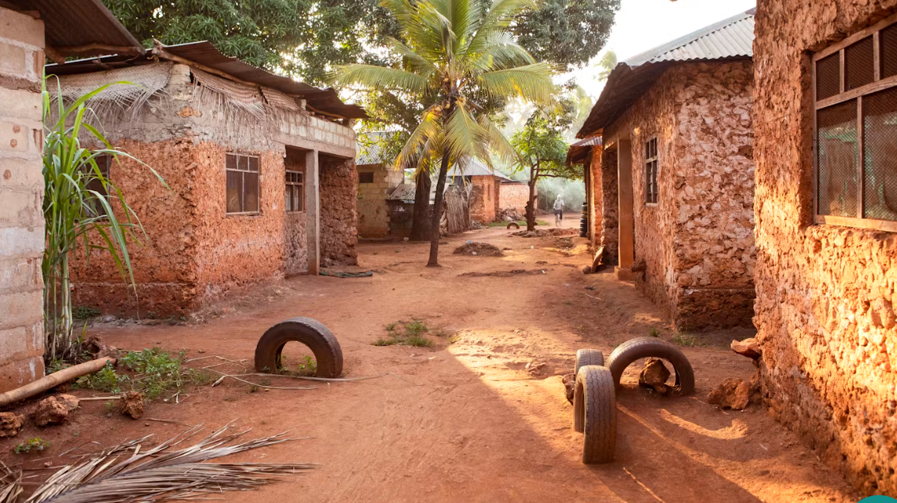
Infrastructure

Slide 3
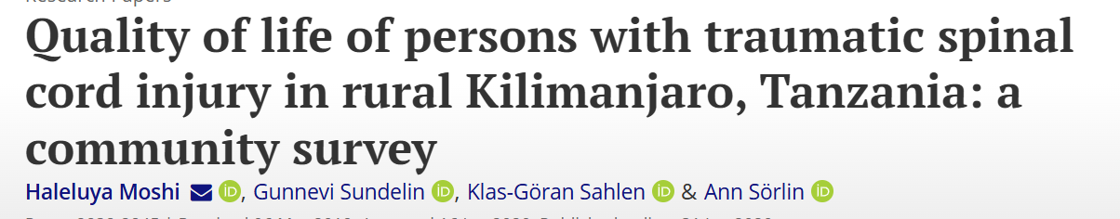
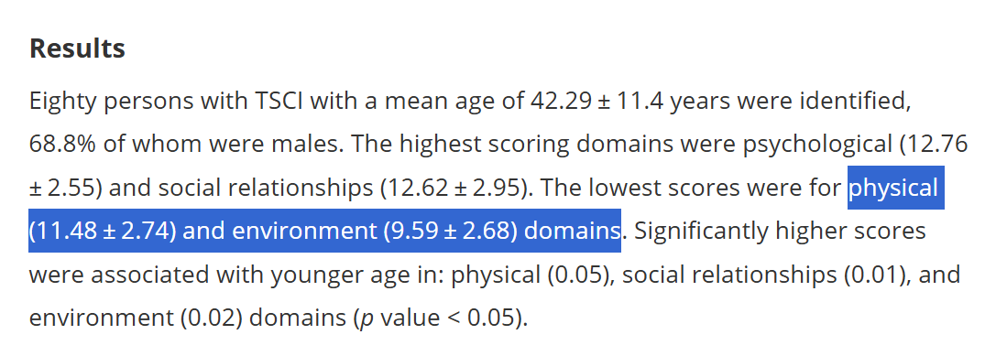

Slide 4
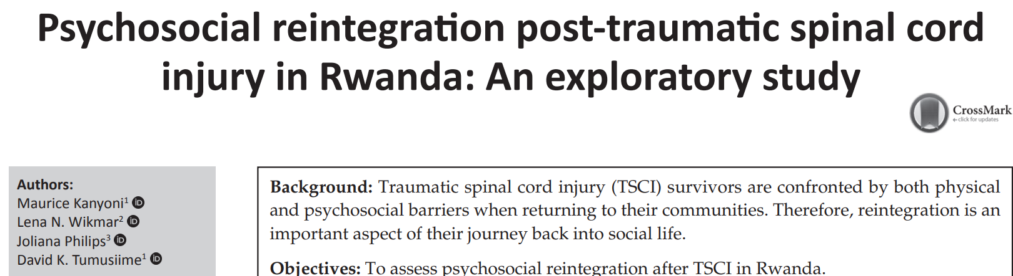
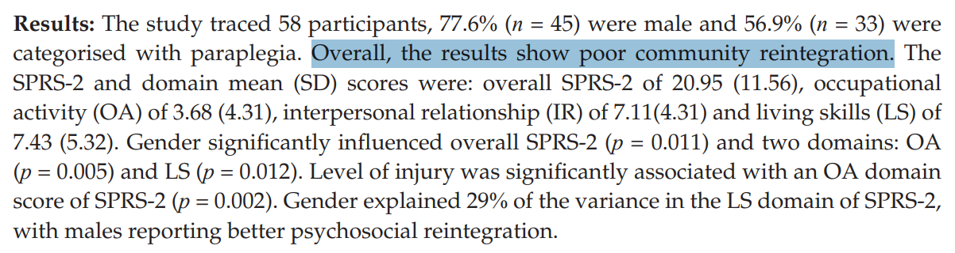
Community Reintegration

Slide 5
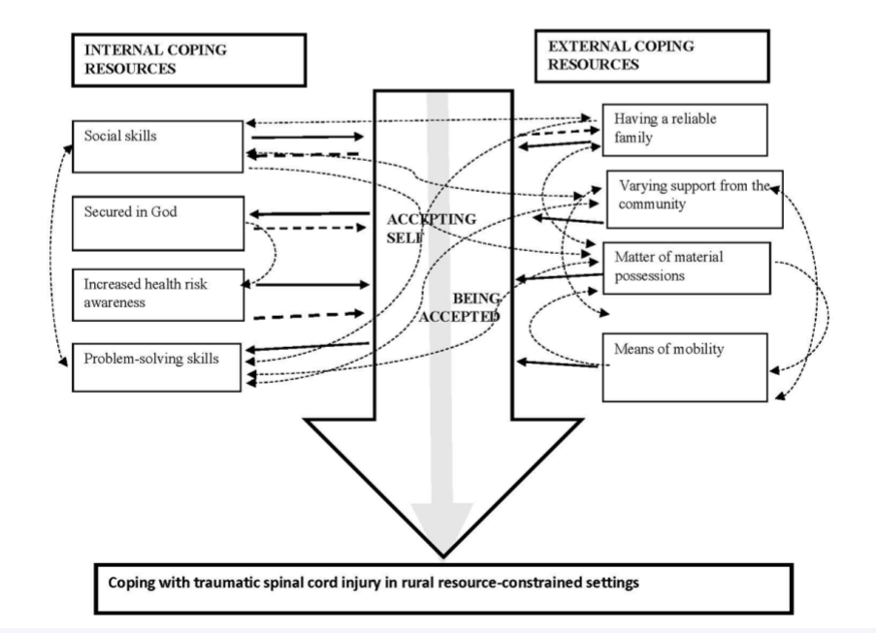
What matters most?

Slide 6
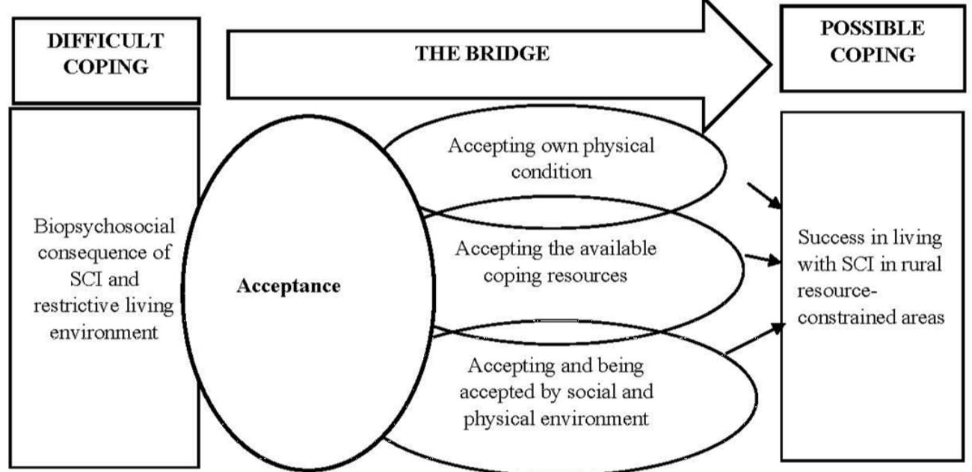
From difficult coping to successful coping

Slide 7
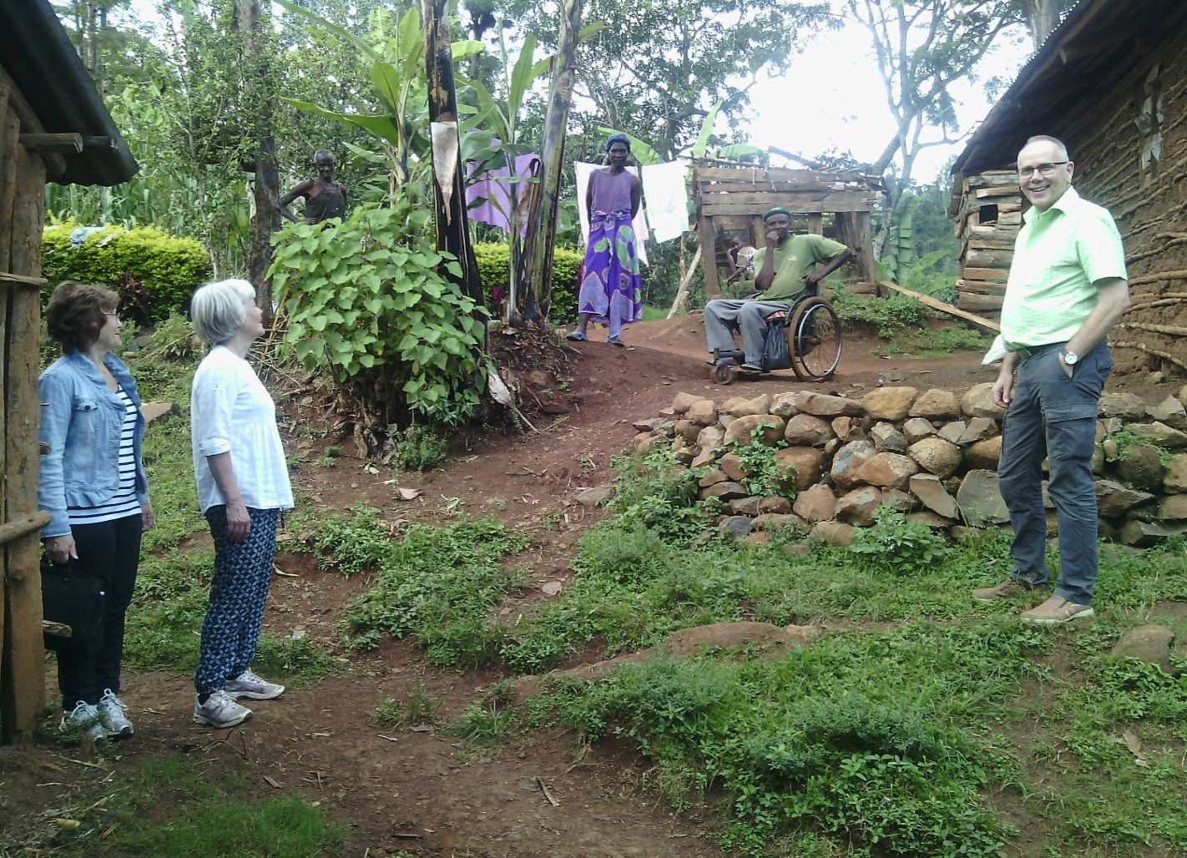
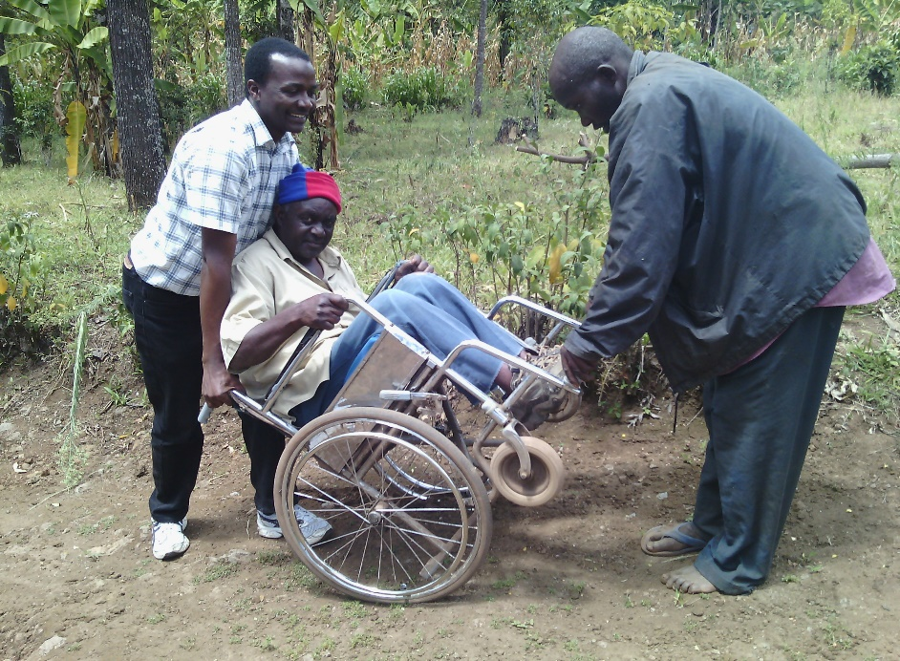
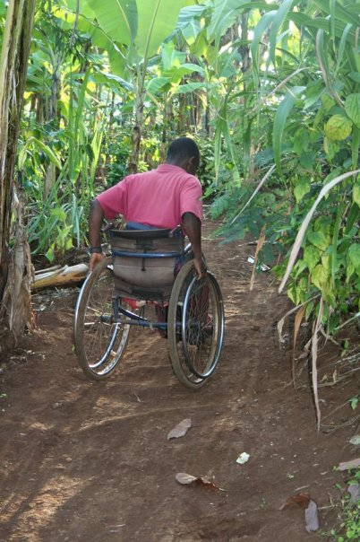
Inaccessible environment
Inaccessible health and rehabilitation services (esp. lack of or inappropriate wheelchairs)
Recurrent complications especially pressure ulcers

Slide 8

The Bigger Picture of a supportive family

Slide 9
True case of a man who successfully and happily lived 32 years with TSCI C5
Supportive family ….grown up children
Material possession prior…something to start with
Healthcare and rehabilitation services
Social skill attracts social support
Hope/Faith….seek peace. The role of religion in rural settings

Slide 10
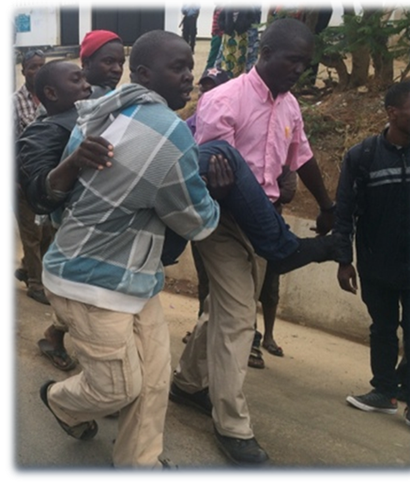
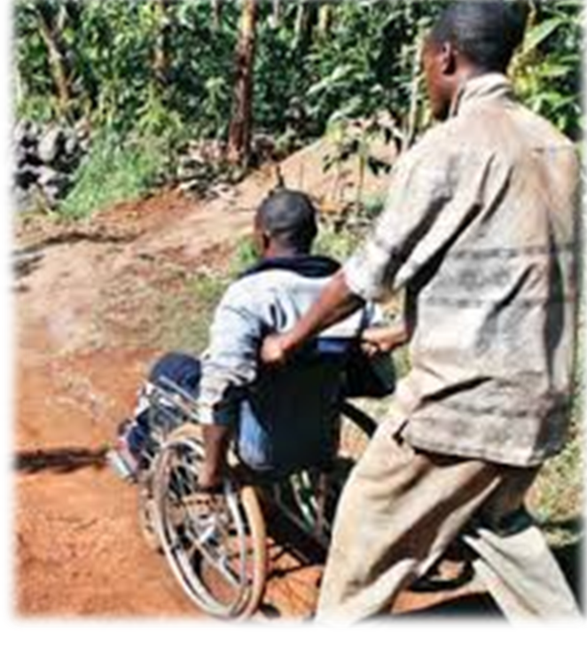

The bigger picture of a supportive Community

Slide 11
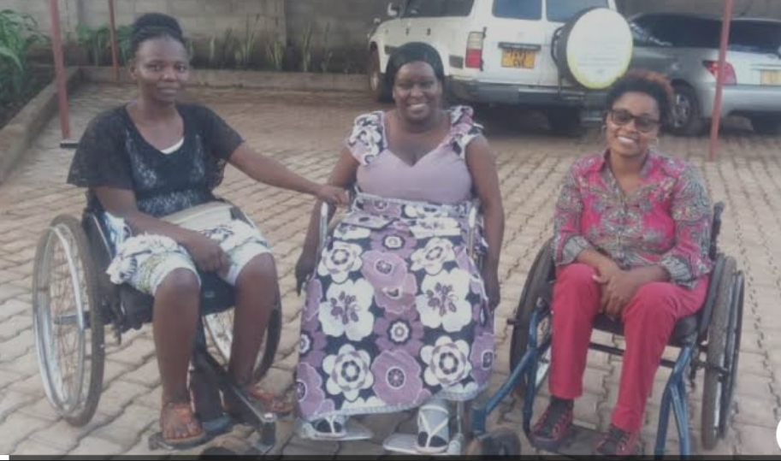
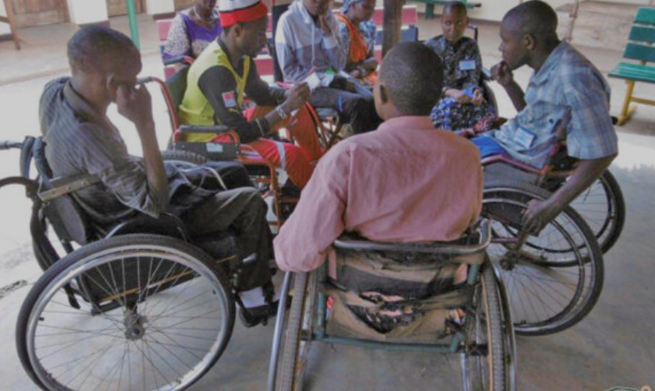
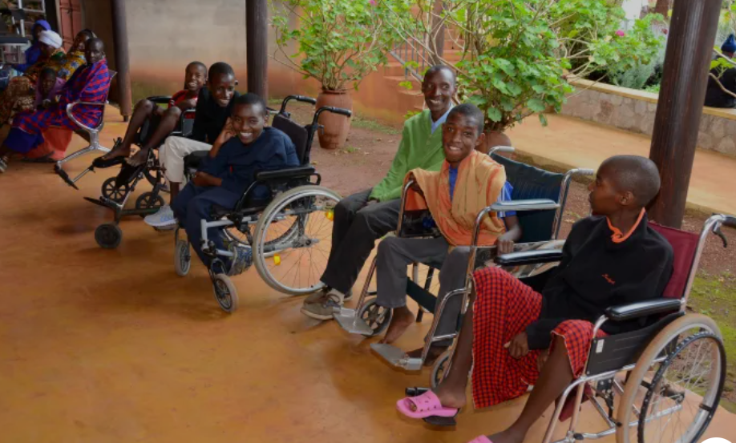
Peer Group Training

Slide 12
Consider Important Others for education on SCI
Family members (cautiously and with consent from the client)
Religion/Beliefs (Diagnosis and prognosis)…
Traditional Medicine/ Traditional healers

Slide 13
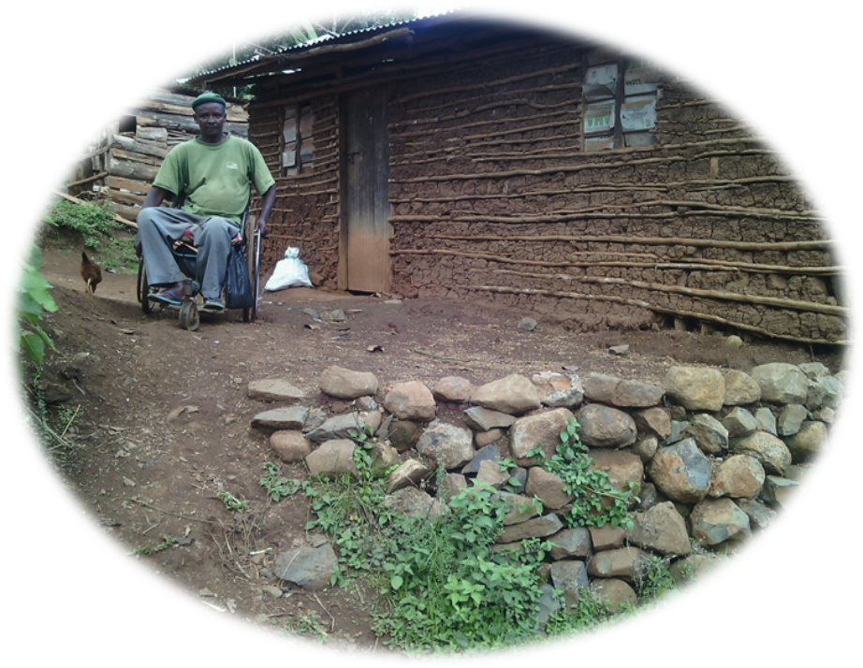
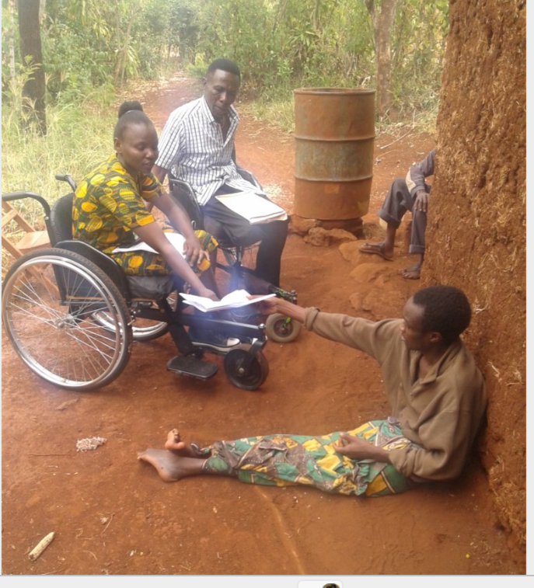
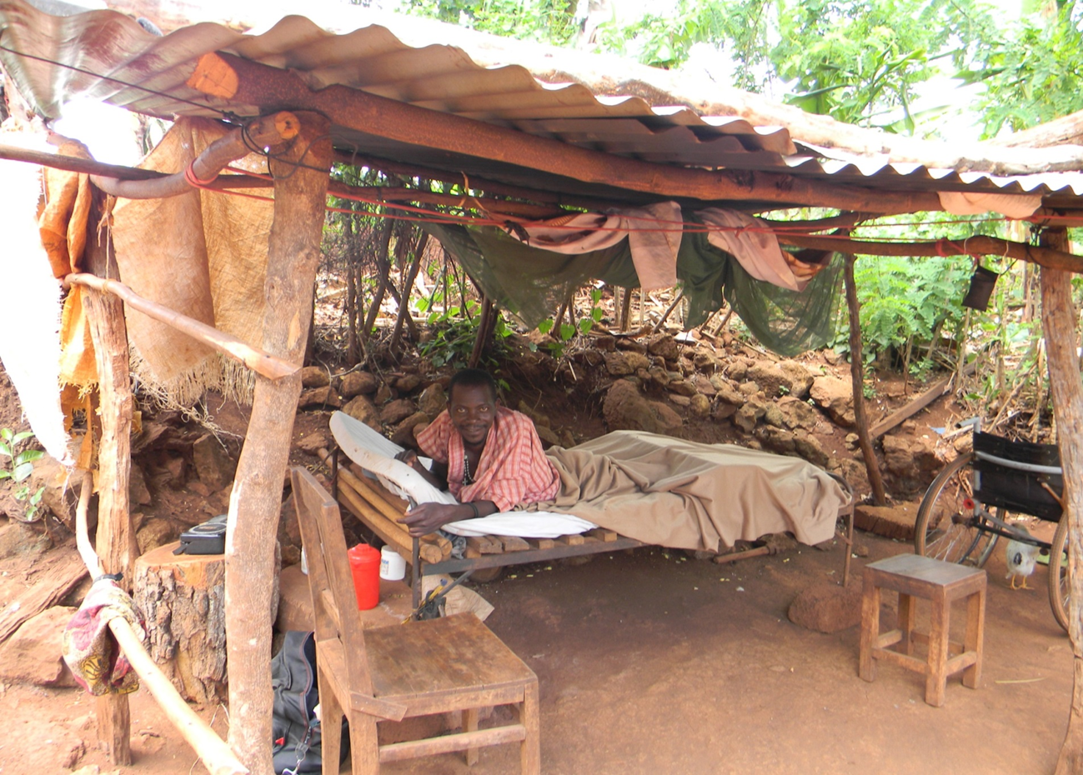
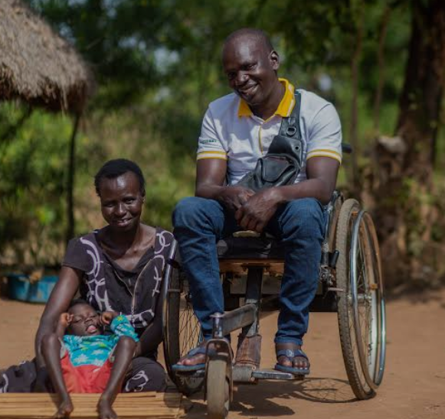
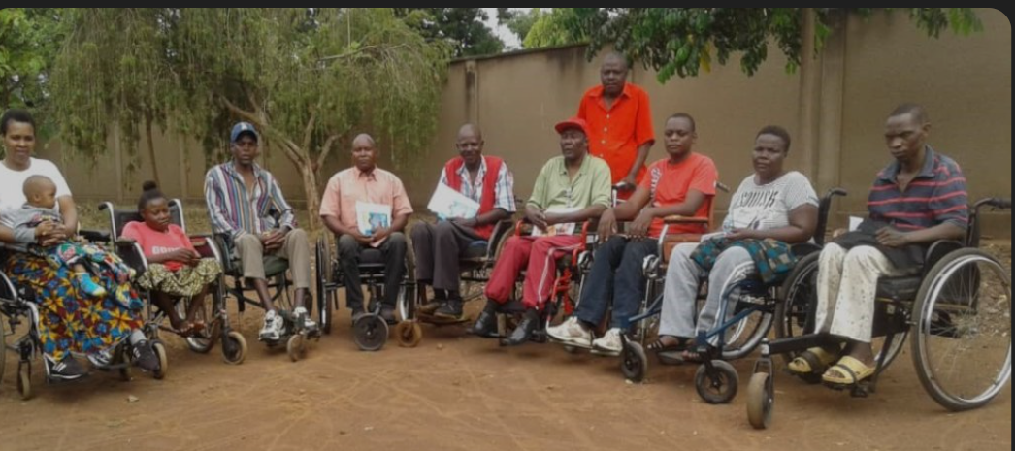
Thank you!

